Slide 1
Title – Price Prediction Of Toyota corolla models.
By
Pranit Pisal

Slide 2

Objective
To predict the Price of Toyota corolla models.

Slide 3

Solution
Doing EDA on current dataset.
Using Linear regression over the current data.
Analysing the insights and Graph patterns.
Finding out the right patterns.
Checking the values on which the price of the models depend upon.
Choosing the efficient AI model.

Slide 4
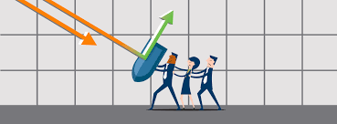

Business Impact
The solution provides help in assigning the predicted Price of the Toyota Corolla cars when there comes a new one in this segment.

